Slide 1


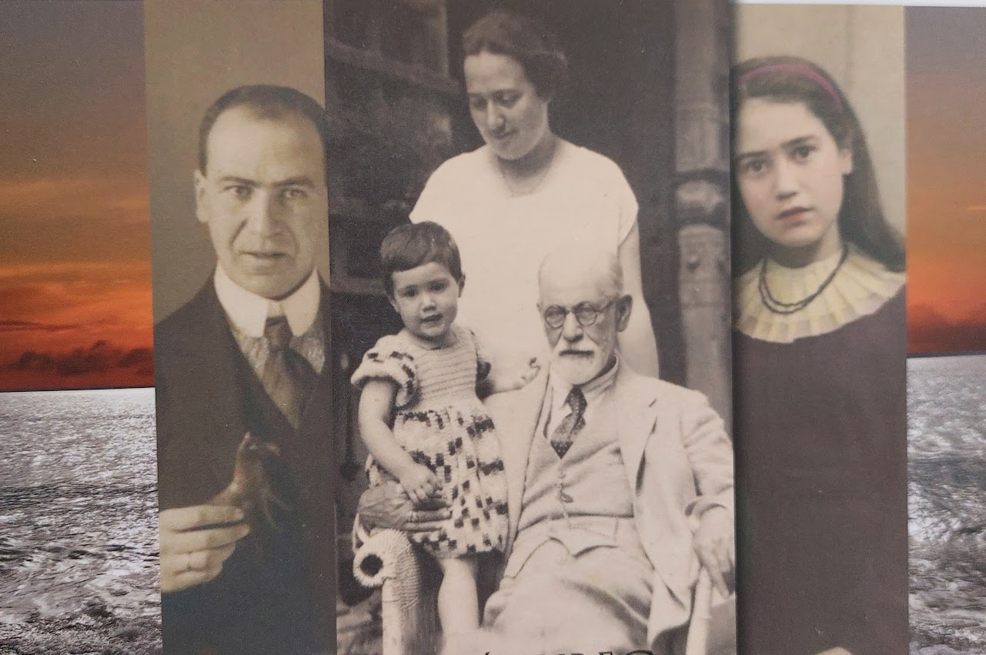
Eva Freud – a 20th century destiny A transversale school collaboration projet as example of good practice​ ​
ConnEcTEd 2022-23
Image 1 Crédit: Oliver and Henny Fuchs Freud Papers, Sigmund Freud Collection, Manuscript Division, Library of Congress, Washington, D.C. Container number 8, series 3 Eva Mathilde Freud Papers.
Christine Schmider, Cindy de Smet (Université Côte d‘Azur, LINE), with the collaboration of Isabelle Sieurin, Philosophy Professor (Lycée Calmette, Nice)

Slide 2
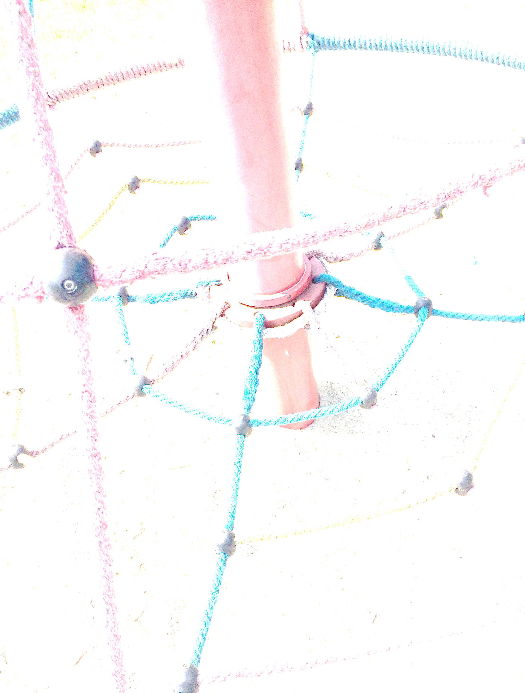
2. Context: Teacher ed students meet pupils
Educational context
competence-based teacher ed…
task-based…
Out of school teaching
School-uni cooperation : teach what you preach
Institutional context
Upper secondary school class specializing in Humanities (HPL – Humanities, Philosophy, Literature)…
Higher Education: binational teacher ed bachelor Nice-Freiburg

Slide 3
2.1 Educational Context
Foreign Language Education and Teacher Education since PISA (and DESI)…
Competence-orientation
The neo-communicative paradim and task-based language ed.
(Meißner/Reinfried 2001, Ellis 2003, Königs 2012, Hallet 2016)
Changes in educational approaches and potential of out of school projects
-> potential of cooperative and collaborative projets „out of school“
Notes:
Wie zusammenzubringen?

Slide 4
2.1 Task based approach as measure of coherence
Competence-/Task-based approach
Holistic, authentic, immersive learning and teaching situations in foreign language teacher education programmes
Competence of „reflective practicioners“ (Schön 1983)
Teach what you preach –coherence between learning and teaching
Project oriented courses which foster relations and connections between different fields of the subject and theory and practice

Slide 5
2.1 Out of school project as measure of coherence
Out of school learning and teaching
Practice related teaching
Sustainable learning
Making Learning material tangible
Offering learning incentives (Salzmann, 2007)

Slide 6
2.1 School – Uni cooperation: Teach what you preach – vector of coherence
Teacher Ed students as learners and teachers
Enhancing self reflection
Developping professional awareness
Sensibilizing for heterogeneity
Questioning of their own teaching practice
Changing of perspective
Familiarizing with colaborative and cooperative teaching methods
Gaining in confidence

Slide 7
2.2 Institutional context :Upper secondary school class specializing in Humanities (HPL Humanities, Philosophy,Literature)…
Pedagogical interest for the pupils
Valorization of the their “Humanities, Literature and Philosophy” speciality through a creative and memorial project
Enhancing the written competences through the writing of choruses and dialogues relating the life of Eva for the theatrical performance
Exchanges with post-baccalaureate students in view of their orientation.
Opening for students to academic work.
30 Pupils in « Terminale », (Upper School graduation Class), 4 hours à week, humanities profile

Slide 8
2.2 Institutional context : binational teacher ed students
Pedagogical interest for the students
Project in collaboration with a French school - pre-professional experience
Experience in project-based teaching approach that they will have to implement later in their own teaching
sharing their linguistic, intercultural and pedagogical skills
Reflecting on their own practice as learner and teacher
10 Students Binational german-french teaching degree in their 3rd Bachelor year.
Mixed german-french group, teaching experience (4 weeks), 2 year studies in their home country, on year mobility.

Slide 9
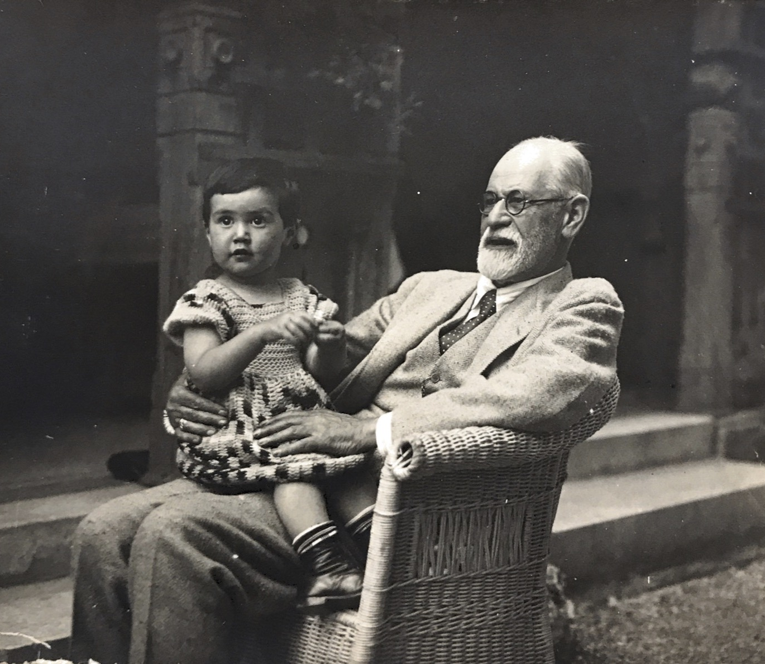
2.2 Presentation of the project. Objectifs, aims and themes
Biography and Scenic expression
Reading and writing workshop on the correspondence of Eva Freud, Sigmund Freud’s granddaughter, a former student of the Lycée de Jeunes Filles, Calmettes de Nice during the Second World War.
Writing texts, stage readings, work on selected letters in German and French
Development of written expression through the writing of choruses and dialogues relating the life of Eva.
Image 2 Crédit: Oliver and Henny Fuchs Freud Papers, Sigmund Freud Collection, Manuscript Division, Library of Congress, Washington, D.C. Container number 8, series 3 Eva Mathilde Freud Papers.

Slide 10
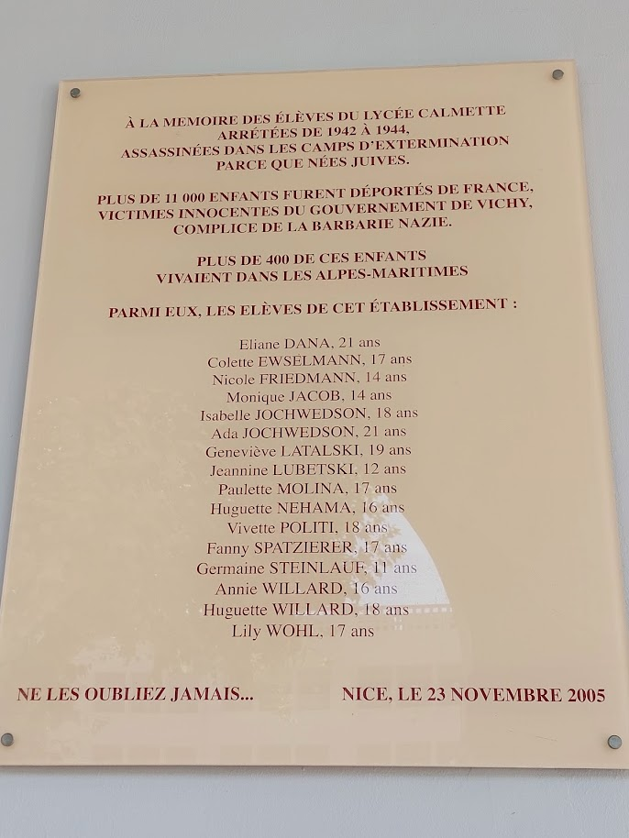
2.2 Presentation of the project. Objectifs, aims and themes
Cultural Studies and Memorial concepts
Academic work on the topography of memory (Places of memory), the discourse of memory (sociological approaches, Maurice Halbwachs, Aleida Assmann, Harald Welzer), family memory, cultural memory)
Understanding the Lycée Calmette as a place of remembrance for the children of the Alpes Maritimes who were deported and murdered in the Nazi death camps
Enhancing critical historical thinking by learning how the knowledge of the past is built from traces, archives and testimonies.
Image 3 Crédit: Isabelle Sieurin

Slide 11
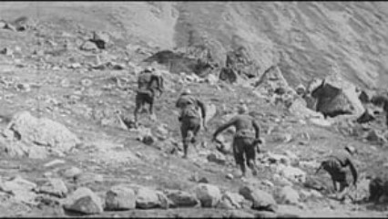
2.2 Presentation of the project. Objectifs, aims and themes
History and knowledge and awareness
Learning about Nice as occupied zone
Knowledge bout the French Riviera as place of refuge for refugee and exil communities
Visiting Thorenc and searching for the traces of the hidden jewish refugees during 1942/43
https://vimeo.com/461756889/8bee73feae

Slide 12
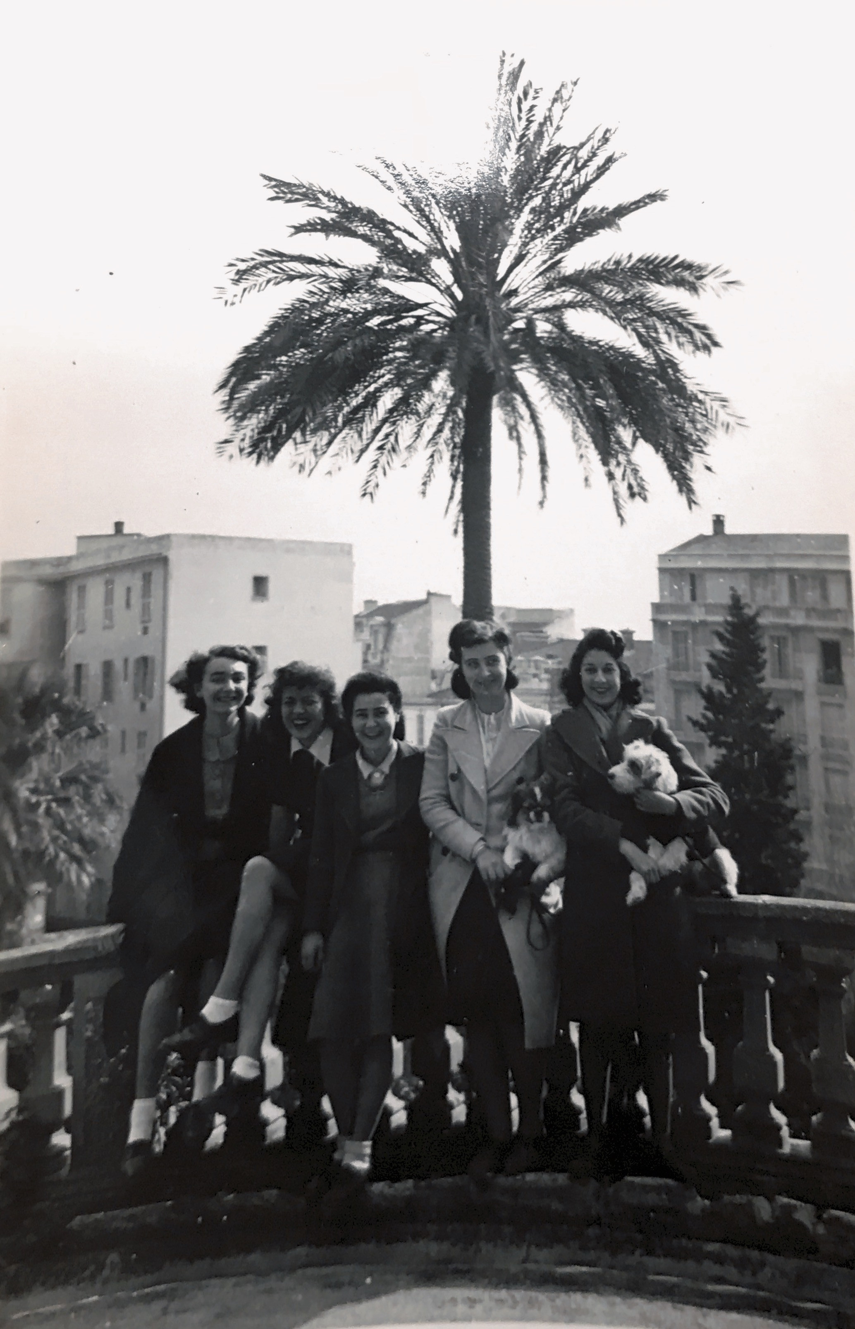
2.2 Presentation of the project. Objectifs, aims and themes
The female condition in the 1940s
Researching the lives of young girls and women during Occupation
Studying School live for girls in the 40s
Learning about the abortion ban, its consequences and the battle fought by Simone Weil
Image 4 Crédit: Oliver and Henny Fuchs Freud Papers, Sigmund Freud Collection, Manuscript Division, Library of Congress, Washington, D.C. Container number 8, series 3 Eva Mathilde Freud Papers.

Slide 13
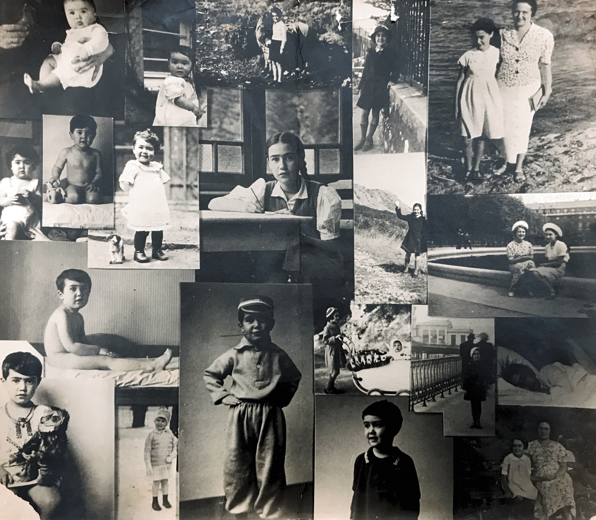
Final product
A theatrical performance based on the life and death of Eva Freud
2 representations:
At the theater of the “Grand Château” and at the German French Cultural Center
Image 5 Crédit: Oliver and Henny Fuchs Freud Papers, Sigmund Freud Collection, Manuscript Division, Library of Congress, Washington, D.C. Container number 8, series 3 Eva Mathilde Freud Papers.

Slide 14
Eva Freud, a 20th century destiny
Powerpoint presentation for the students who participate in the
Project with historical sources, tasks, assignements
and student/pupil outputs
A collaborative School Project, 2022/23 LLCER 3
Littérature (HLECVL52), Histoire des idées (HLECVL52) et Expression écrite (HLECLL5), Mme Schmider/ Mme Sieurin

Slide 15

Image 6 Crédit: Oliver and Henny Fuchs Freud Papers, Sigmund Freud Collection, Manuscript Division, Library of Congress, Washington, D.C. Container number 8, series 3 Eva Mathilde Freud Papers.

Slide 16
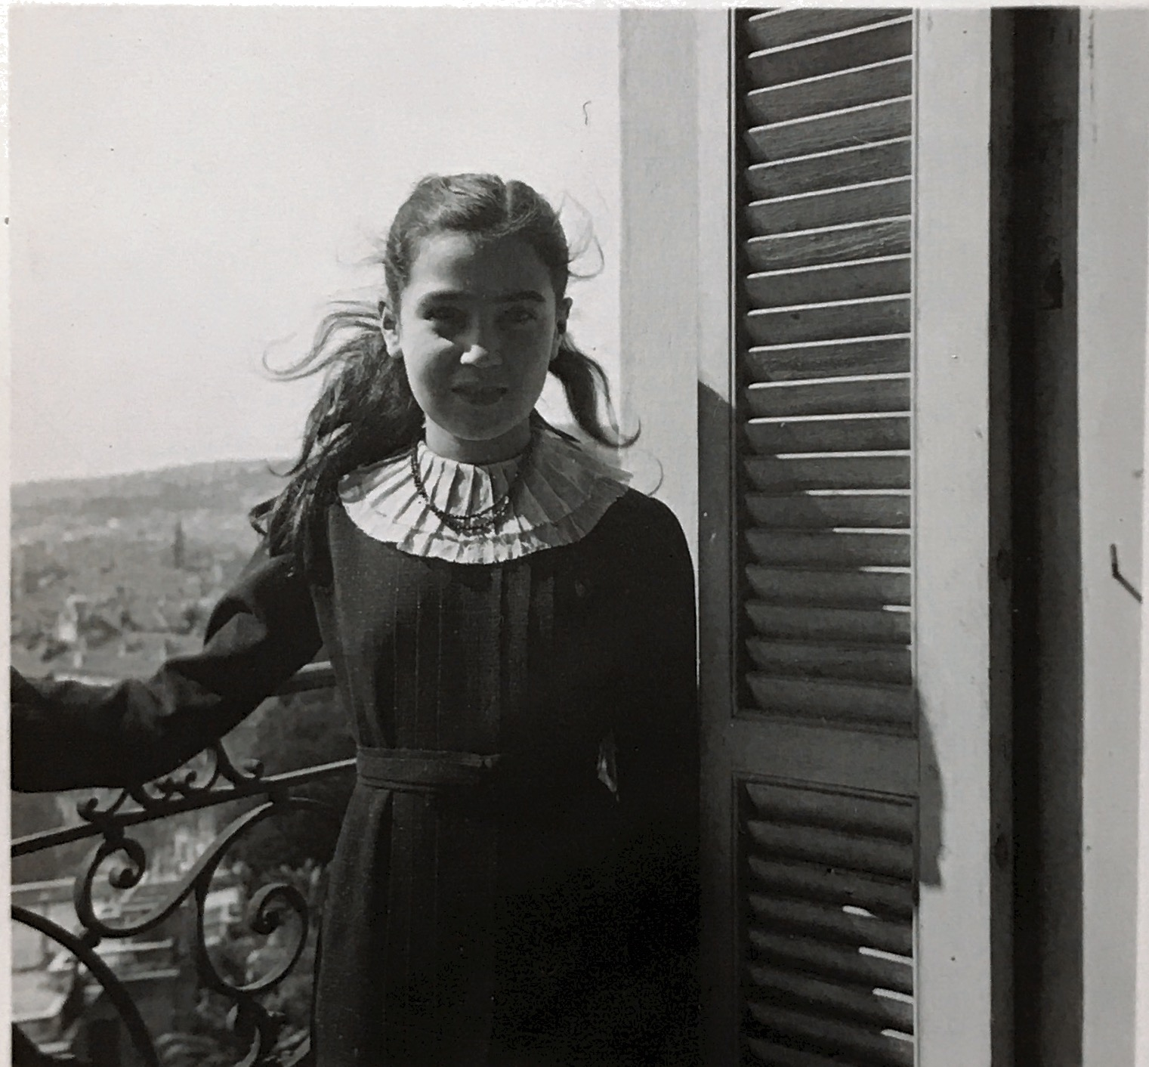
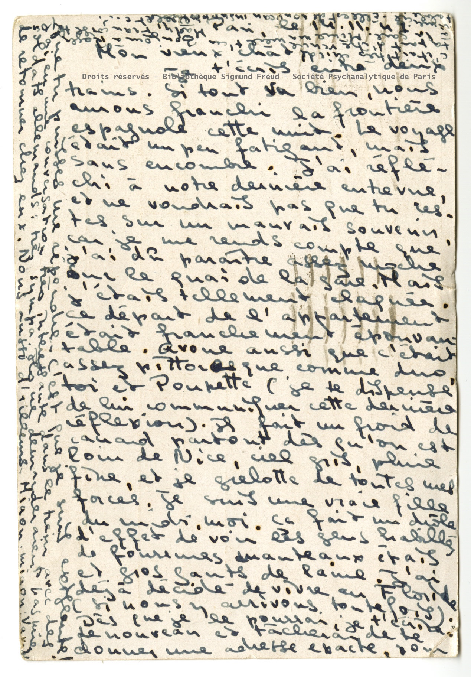
The Life of Eva Freud
Image 7 Crédit: Oliver and Henny Fuchs Freud Papers, Sigmund Freud Collection, Manuscript Division, Library of Congress, Washington, D.C. Container number 8, series 3 Eva Mathilde Freud Papers.

Slide 17
Who was Eva Freud?
Born on 3rd of september 1924 in Berlin
Sigmund Freud’s granddaughter
Came to Nice in 1934 after her family had to flee the rising nazism in Berlin
Pupil at Lycée Calmette Nice from von 1934 bis 1942
Died on 4th of november 1944 after an illegal abortiong

Slide 18
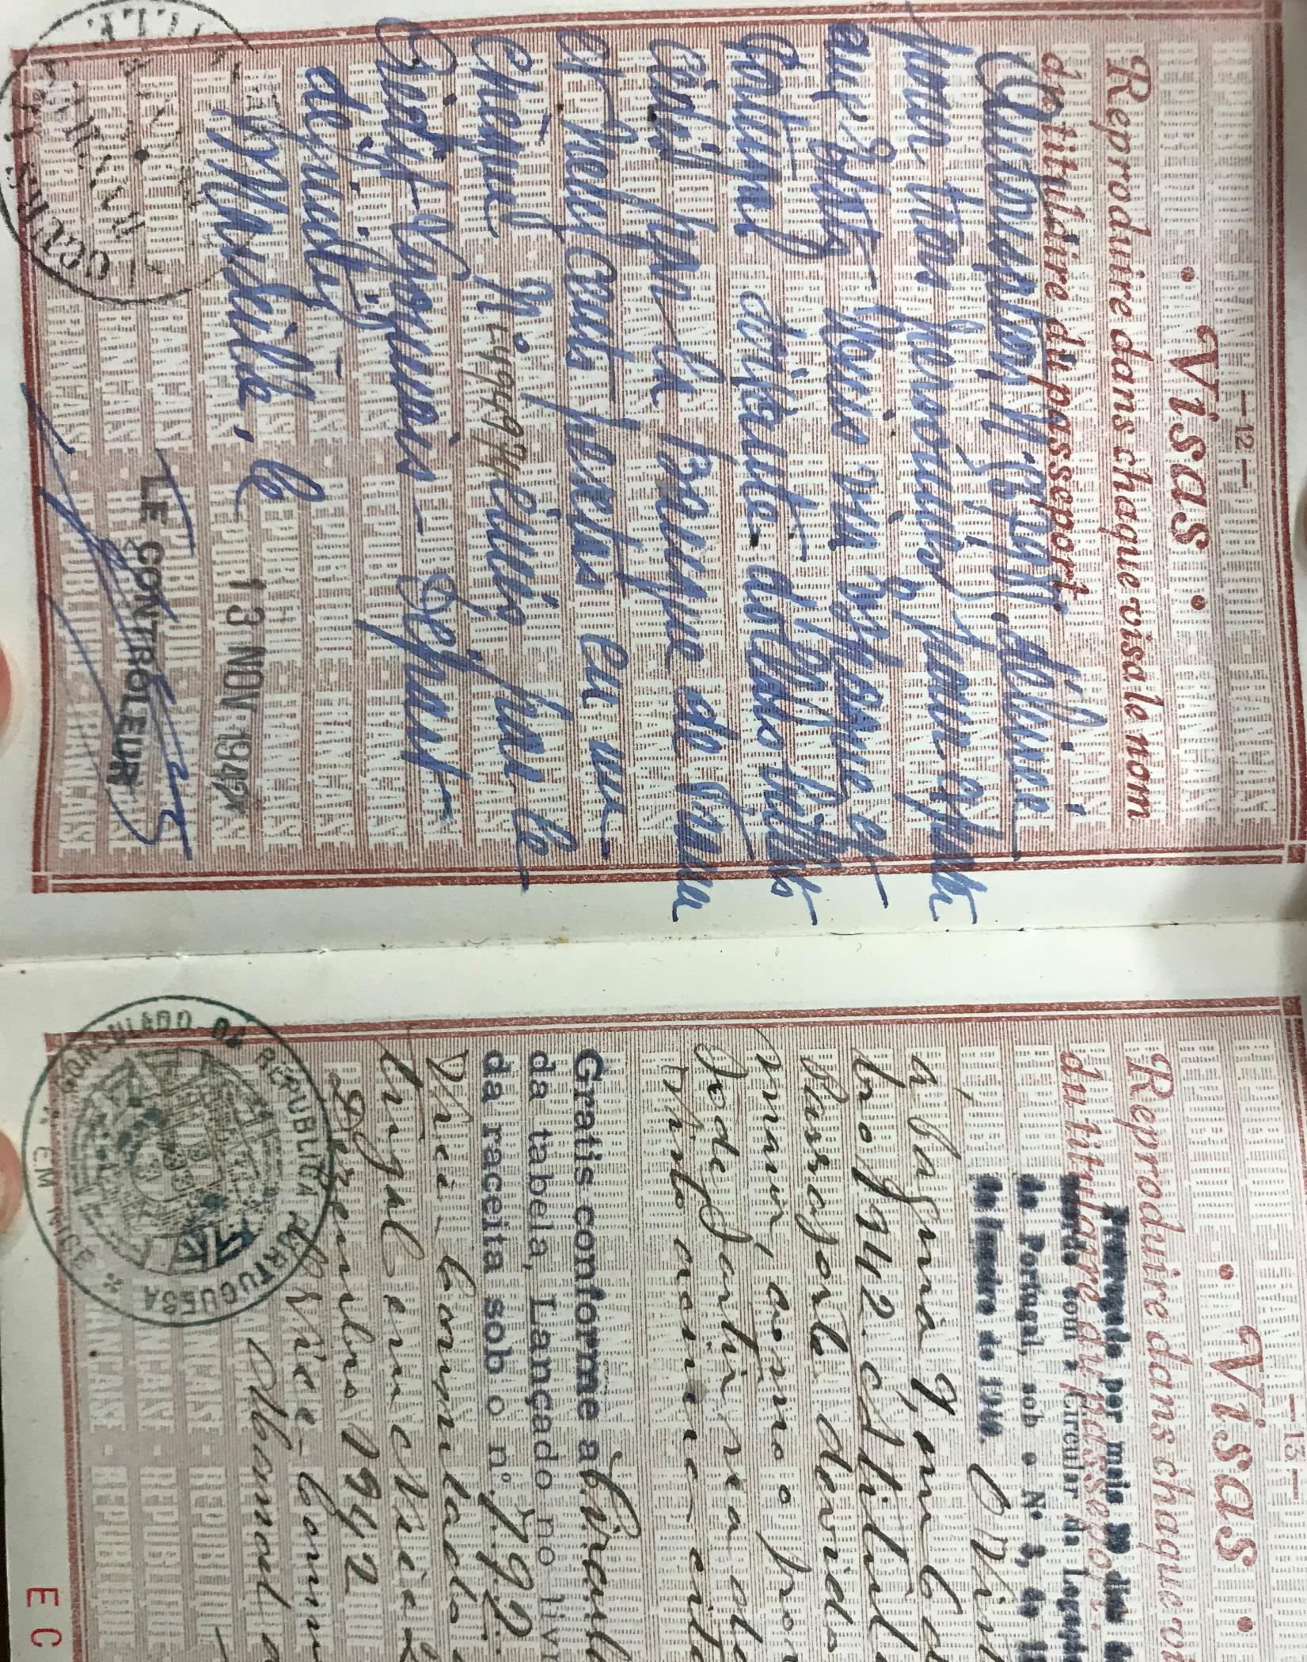
1. Why this project about Eva Freud?
Her live and death sheds light on:
The situation of the European Jews who were in exile in Nice, or on the French Riviera, during the occupation.
Historical context National Socialism
Persecution and exile of the European Jews
Image 8 Crédit: Oliver and Henny Fuchs Freud Papers, Sigmund Freud Collection, Manuscript Division, Library of Congress, Washington, D.C. Container number 8, series 3 Eva Mathilde Freud Papers.

Slide 19
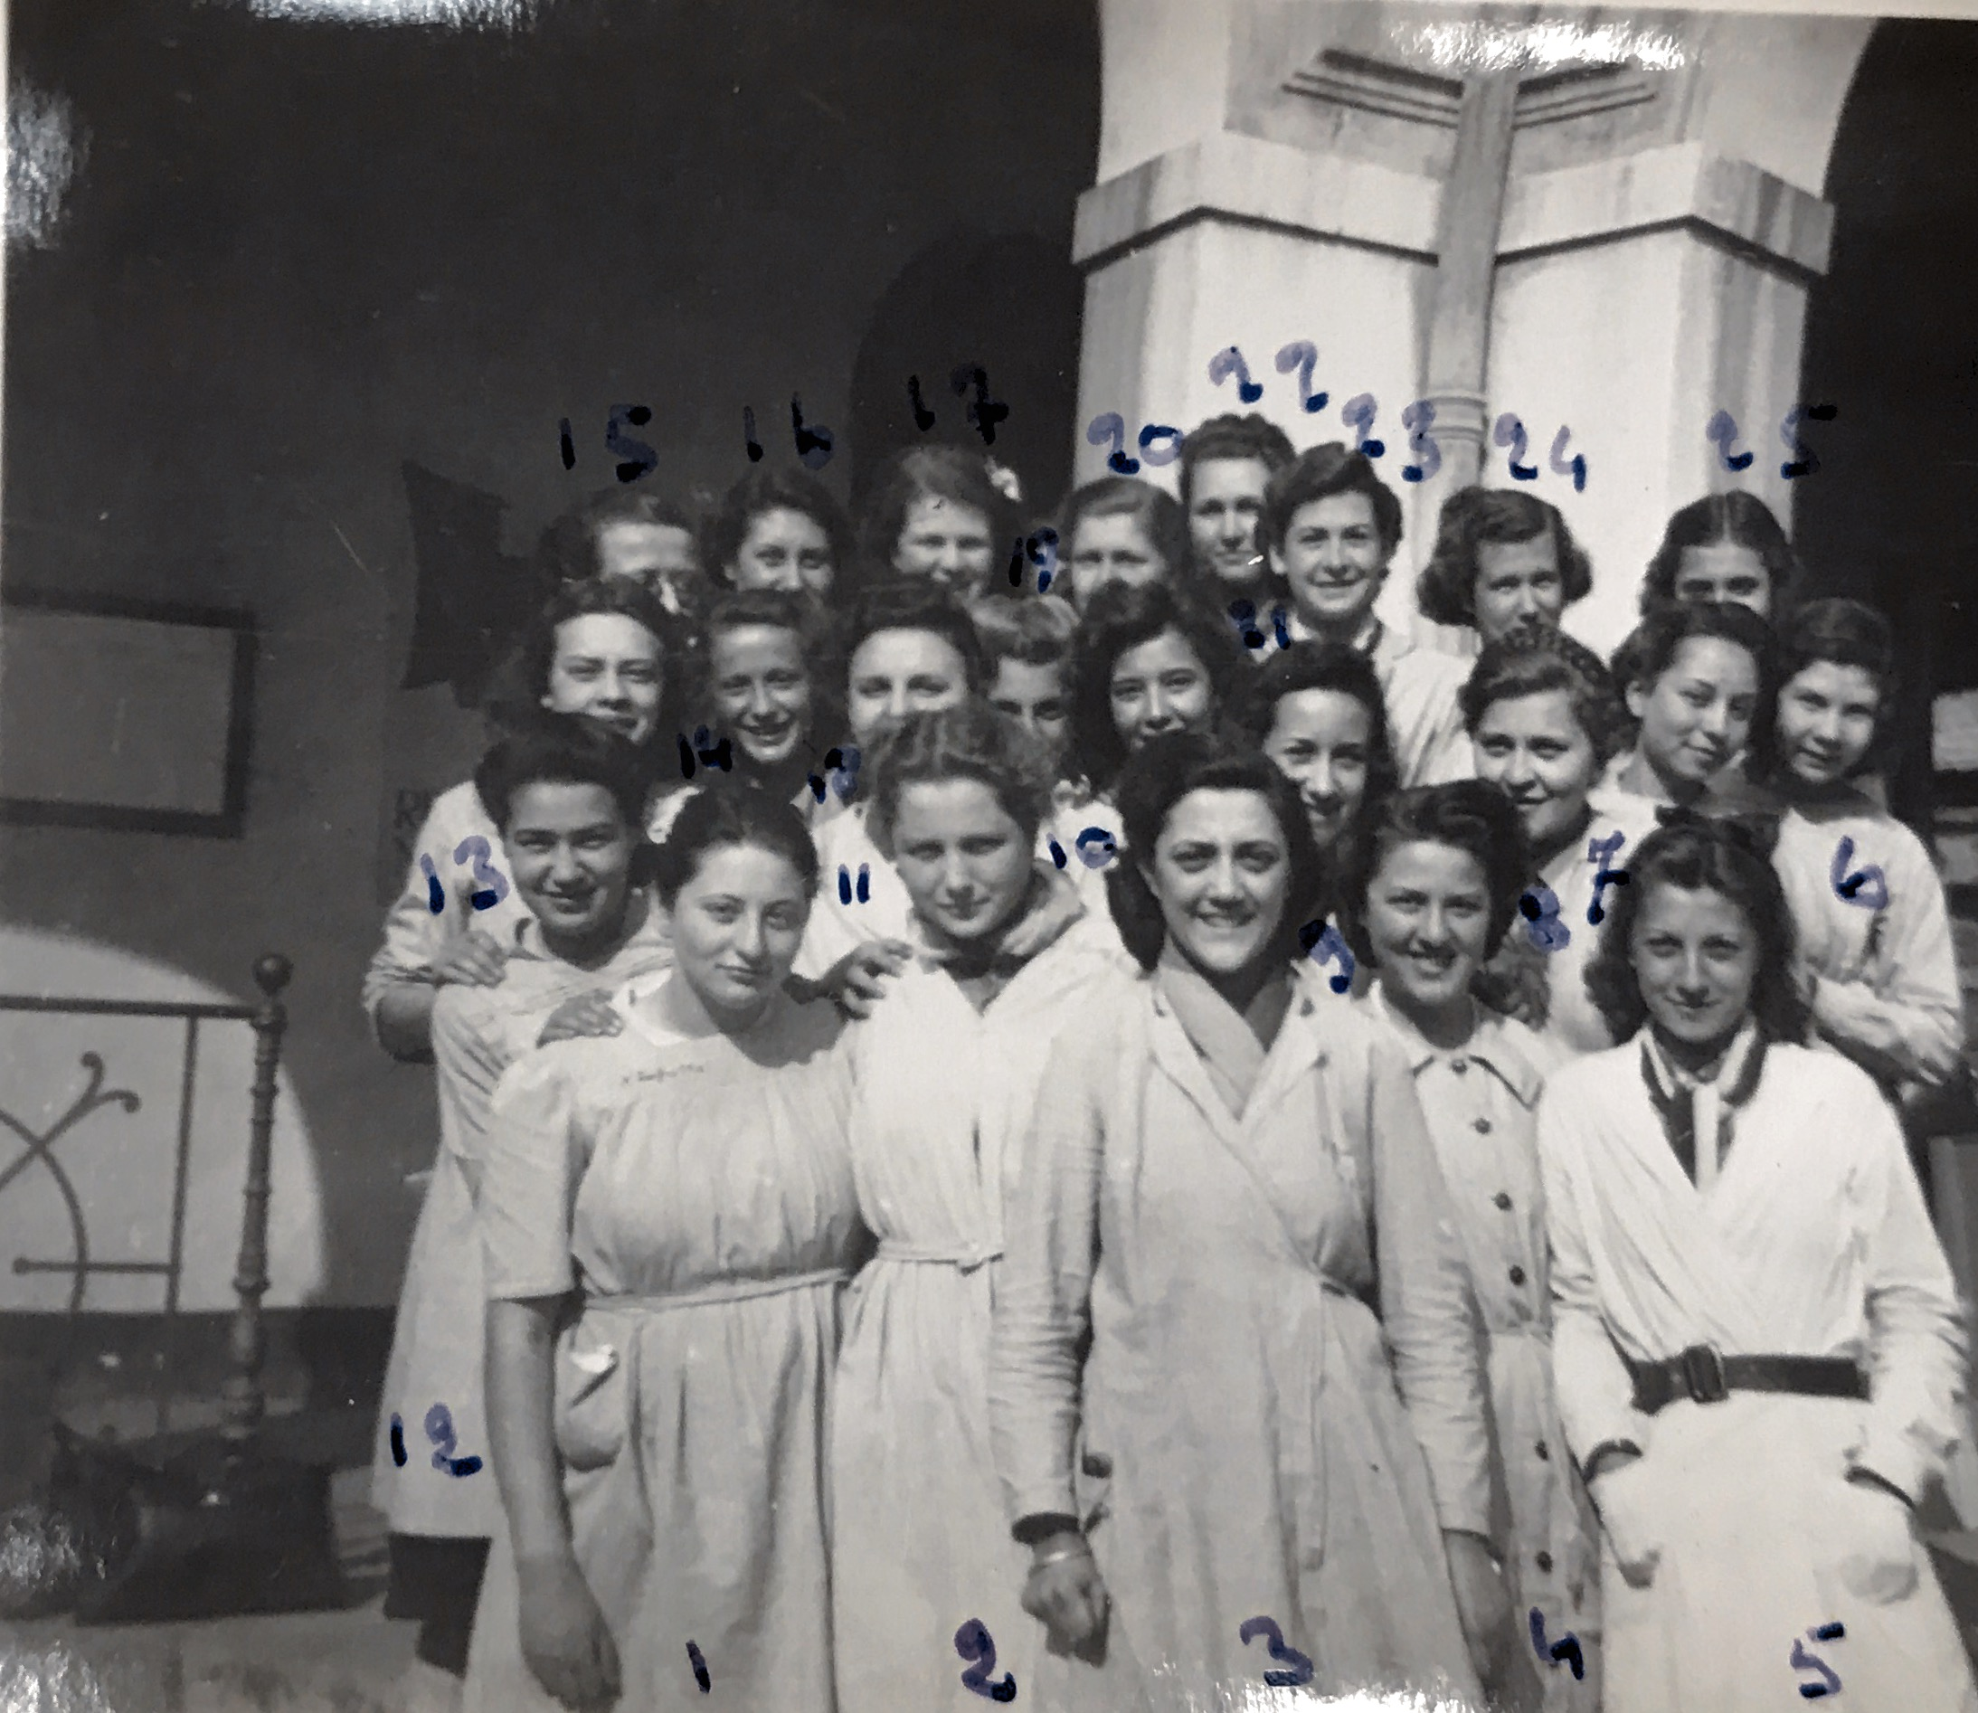
1. Why Eva Freud?
Her live and death sheds light:
On the condition of young girls and women in the 1940s.
Female Condition
Abortion ban
School education in the 40s
Image 9 Crédit: Oliver and Henny Fuchs Freud Papers, Sigmund Freud Collection, Manuscript Division, Library of Congress, Washington, D.C. Container number 8, series 3 Eva Mathilde Freud Papers.

Slide 20
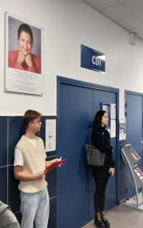
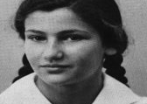
1. Why Eva Freud?
Simone Veil – un combat pour le droit à l’avortement​
Présentation de la personnalité et de la biographie en tant qu’ancienne élève du Lycée Calmette​
Découverte de son lien avec Eva​
Etude de son parcours politique et de son combat pour le droit à l’avortement​
Image 11 Crédit: Mémorial de la Shoah
Image 10 Crédit: Christine Schmider
Notes:
Photo Simone Veil und Bio

Slide 21
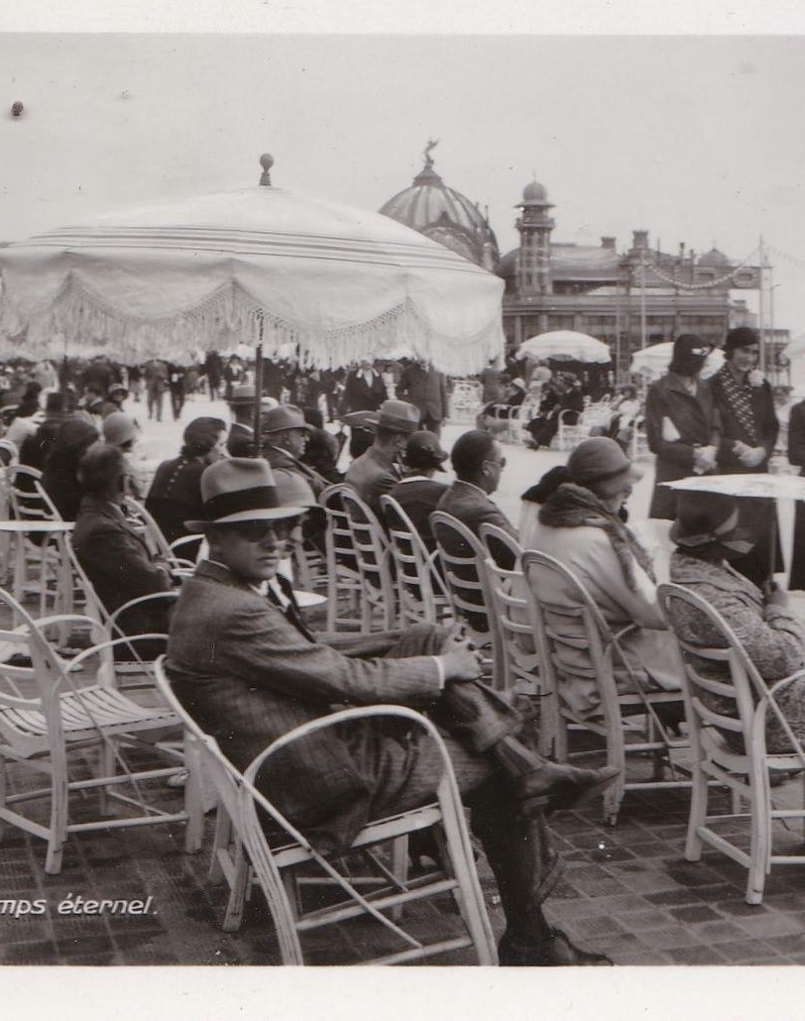
1. Why Eva Freud?
Their lives and deaths shed light:
About Nice and the Lycée Calmette
as topography of memory
as archives of history
Image 12 Crédit: Oliver and Henny Fuchs Freud Papers, Sigmund Freud Collection, Manuscript Division, Library of Congress, Washington, D.C. Container number 8, series 3 Eva Mathilde Freud Papers.

Slide 22

2. The Project
Over several courses
Over 2 semesters
In collaboration with the terminal HPL of the Lycée Calmette and their philosophy teacher.
With joint meetings
With an excursion to Thorenc
With a final theater performance

Slide 23
3. The historical material
The Correspondance between Eva and Hélène Doub. (PDF No 01)
The School register and class photo (PDF No 02)
The « carnet d’observation des parents d’Eva (PDF No 03)
Police archives related to the arrest of jewish families in Thorenc (PDF No 04)
Various pictures and photographs
Image 13 Crédit: Isabelle Sieurin
Notes:
Besseres Phot

Slide 24
4. Tasks
Projet Eva Freud 2023. Travail d’écriture n°1 à faire par groupes de deux ou trois élèves. A envoyer en word/pages/pdf à l’enseignant.
Lire les documents, visionner les vidéos, prendre des notes avant de commencer le travail d’écriture.
1. Objectif : Écrire deux textes sur la vie d’Eva (de sa naissance 1924 au années 30, jusqu’à ses douze ans). Ces textes peuvent prendre des formes très diverses en fonction de votre inspiration : récits, poésies, dialogues…
Texte n° 1 : Eva à Berlin.
Texte n° 2 : Eva à Nice dans les années 30 à Nice. Les deux meilleurs textes seront utilisés comme choeur/voix off racontant/commentant la vie d’Eva sur les photos pour le spectacle.
Suivre le lien pour comprendre ce qu’était/est un coeur au théâtre

Slide 25
4. Tasks
2. Liens vidéos et podcast pour trouver toutes les informations utiles pour la rédaction de vos textes :
- Emission sur Eva Freud
- Podcast sur Eva Freud
- Biographie Eva Freud
3. Références très utiles pour trouver toutes les informations nécessaires pour la rédaction de vos textes : Ce document est essentiel !!! :
- Répères chronologiques
- Entretien sur Eva Freud
- Vidéo sur Nice sous l'occupation
- Livre : Sieurin, Qui a tué Eva Freud, fragments d’une vie à Nice, Editions Mémoires millénaires.

Slide 26
4. Tasks
4. Lieux de mémoires
I. Lisez l’article de Jan Assmann Kollektives Gedächtnis und kulturelle Identität et résumez ses thèses principales
II. Répondez aux questions:
1. Qu’est-ce qu’un lieu de mémoire ?
2. Quel est l’historien qui a développé ce concept ?
3. Citez quelques lieux de mémoire de la première Guerre Mondiale et de la Seconde Guerre mondiale ?
4. Peut-on dire que le lycée Calmette est un lieu de mémoire ? Justifiez votre réponse. Quel était son nom pendant la seconde guerre mondiale ?
5. Retrouvez le noms, âges, numéros de convoi des élèves qui ont été déportées sans retour parce que nées juives ?
6. Qui est Simone Veil ? Quand était-elle élève au lycée ? Quand a-t-elle été arrêtée ? (voir corrigé p. 36-38 template)
III. Rédigez un texte sur un lieu de mémoire de votre choix. En quoi ce lieu correspond-il à la définition de Jan Assmann?

Slide 27
4. Tasks
4. Lieux de mémoires – Thorenc
Rédigez un texte sur le village de Thorenc comme lieu de mémoire en vous basant sur votre expérience et impressions de l’excursion dans l’arrière-pays.
Illustrez le texte avec des photos que vous aurez prises.

Slide 28
4. Tasks
5. Elaborez une séquence de cours pour une classe de 3è en vous servant de tous les documents distribués.
-Définissez les objectifs linguistiques, culturels, communicatifs et éducationnels.
-Précisez les activités langagières.
-Indiquez les tâches intermédiaires et la tâche finale.
- Donnez des précisions sur l’évaluation et les devoirs à la maison
Quand vous aurez terminé la séquence, demandez un feedback à deux autres personnes.

Slide 29
5. Outputs
Students’ and pupils’ productions:
Creative texts, graphic novels, poems on the life of Eva Freud (PDFs No 07, 08, 09)
Texts about places of memory (PDF No 11)
Texts about Thorenc and its memorial topography (PDF No 13)
Lesson plan « Eva Freud, a 20th century destiny » (PDFs No 14 and No 15)
Video for the theater representation (link on teams)

Slide 30
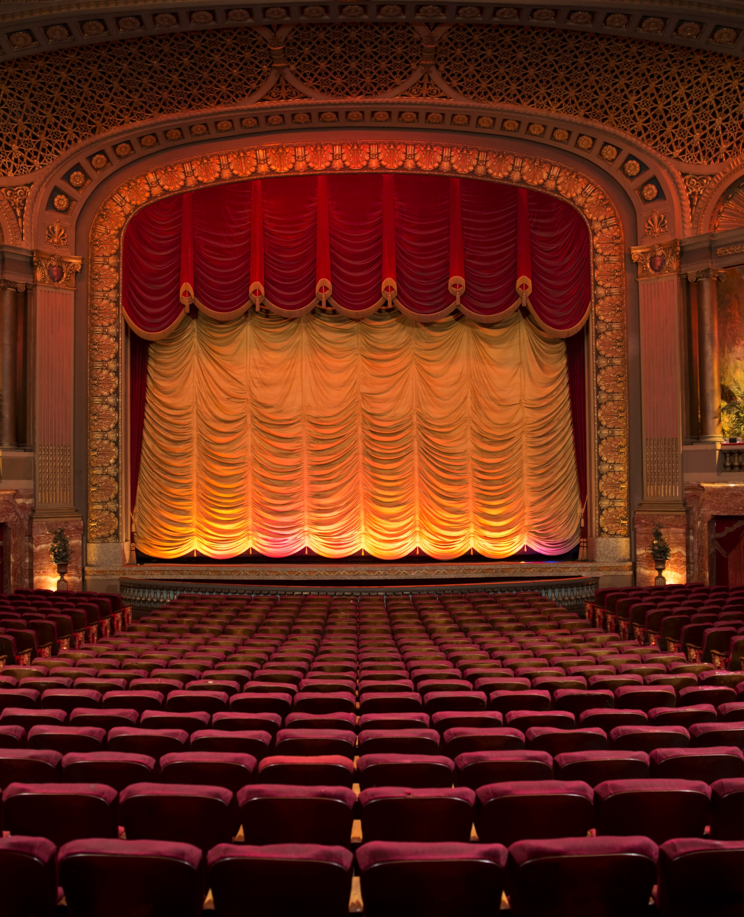
6. Important dates
First meeting at the Calmette high school between the students of the final year of high school specializing in HLP and the undergraduate students. Presentation of the Calmette high school as a place of memory of the Shoah in Nice. Meeting with the President of the AMEJDAM (Association for the Memory of Deported Jewish Children of the Alpes-Maritimes) Mrs. Merowka, who will explain to the students the historical research process to find the names of the deported girls from the high school in order to affix the commemorative plaque at the Calmette high school. Presentation of a video, made by the students.
Second meeting between students and high school students: workshop of theatrical reading of Eva Freud's letters at the Faculty of Letters. Welcome by the director of EUR Creates, Mr. Aubert.
Outing to Thorenc: discovery of Eva's pen pal Hélène Dub's hiding place, of the various places where Jews were arrested and of the commemorative plaque
Performance of theatrical readings in collaboration with the students.Théâtre du Grand Château, Valrose

Slide 31

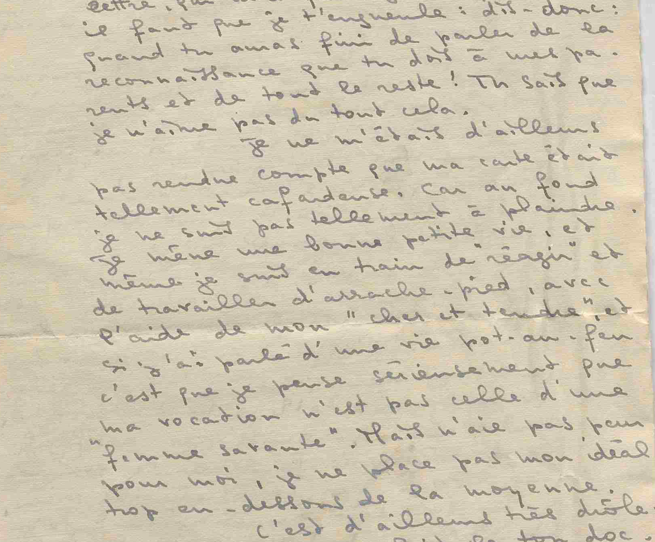
7. Cours programme and structure
Working material:
Letters, photographs, documents from archives, historical sources
Procedure:
Description and analysis of documents and their contextualization
Writing workshop – student/pupils’ texts and scenarios
Scenic representation andreading presentation of letters and student/pupil’s texts
Grading: 1 grade for active participation in the project. 1 grade for production within the course. The average will be counted for all courses involved.
Image 14 Crédit: Oliver and Henny Fuchs Freud Papers, Sigmund Freud Collection, Manuscript Division, Library of Congress, Washington, D.C. Container number 8, series 3 Eva Mathilde Freud Papers.

Slide 32
Final assessment : The project as vector of coherence
Transdisciplinarity of subjects
Connecting different fields of CK (history, littérature)
Connecting CK, PCK and PK through the project work
Linking theory and practice
Enhancing self reflection
The pupils and students felt that they had:
learned to reflect out of the box,
adapt to unfamiliar environments
adopt new perspectives
Create links between different fields of knowledge

